Slide 1

ANNAMACHARYA INSTUTE OF TECHONOLOGY AND SCIENCES :: TIRUPATI
(AUTONOMOUS)
Socially Relevant Project
On
COVID PREVENTION SECURE
PROJECT GUIDE
Asst Prof. T Sai Kumar
Project Batch – 26
Anjali B
Balachandar P
Mounika T
Pavan Kalyan Y
Prathap P
20AK5A0503
20AK5A0504
20AK5A0505
20AK5A0506
20AK5A0507

Slide 2
CONTENTS
ABSTRACT
INTRODUCTION
DISADVANTAGES OF EXISTING SYSTEM
ADVANTAGES OF PROPOSED SYSTEM
FEATURES
SOFTWARE AND HARDWARE REQUIREMENTS
ARCHITECHTURE
SNAPSHOTS
CONCLUSION
FUTURE SCOPE

Slide 3
ABSTRACT
There is a New Public health crisis threatening all over the world with the
emergences and spread of COVID19. Due to this issue lack of People are losing
their lives to overcome this problem we should prevent and secure Ourselves.
Through an Assessment i.e., a person’s health status will be noticed, Here the
three preventions of indicators are Green (Safe), Orange (A person in a family
is affected due to covid and prevention for family members), Red (High
Temperature, Cold, Body Pains, Headache). Through this Indications the person
will be knowing his health status and get’s the doctor’s prescription and
instructions, appointments. If requires, the patient will get the details of
blood/plasma and oxygen availability. By this, the Effected person can be
prevented and secured from Threats of Covid19.

Slide 4
INTRODUCTION
In this project through an assessment i.e., a person’s health status will be noticed.
Here, we used three indicators Green(Safe),Orange(Might be partially Effected),Red(Might be Effected).
Through this Indications the person will be knowing his health status.
And get’s the doctor’s prescription if requires, the patient will get the details of blood/plasma and oxygen availability.
Any person can Book the Covid Vaccination slot
Affected Person can book a Covid Test
By this, the Effected person can be prevented and secured from Threats of Covid19.

Slide 5
DISADVANTAGES OF EXISTING SYSTEM
In existing system remaining people’s health status will not be visible.
Nearby Blood and Oxygen contact details are not available in Existing system.
Prescriptions are not available in Existing system.
In Existing System we cannot use it for an organization only

Slide 6
ADVANTAGES OF PROPOSED SYSTEM
Generating Health Analysis of a Person by Assessment and knowing his health status.
Knowing Others Health Analytics of their Organization.
Getting Prescription as per the Health status.
Getting Availability Contacts of Oxygen and Blood.
Registering for Covid Test and Covid Vaccination

Slide 7

FEATURES
LOGIN / CREATE Account
Application Management by Administrator Login
Taking Assessment and Getting Health Results
Covid Prevention Secure
Getting Prescriptions According to Health Results
Checking all Others Health Status
Registering for Covid Test
Getting Blood / Plasma & Oxygen Availability Contact Details
Registering for Covid Vaccination
Fig : Covid Prevention Secure Architecture

Slide 8
SOFTWARE AND HARDWARE REQUIREMENTS
Software Requirements
Operating system : Android, IOS
Web Application : MIT App Inventor
Database: Tiny DB
Web Server: Google App Engine
System Development Kit: App Inventor_Setup_v_2_2
Hardware Requirements
Android Mobile Phone (or) Android Tablet

Slide 9
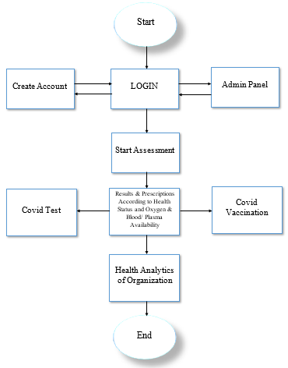
ARCHITECHTURE

Slide 10
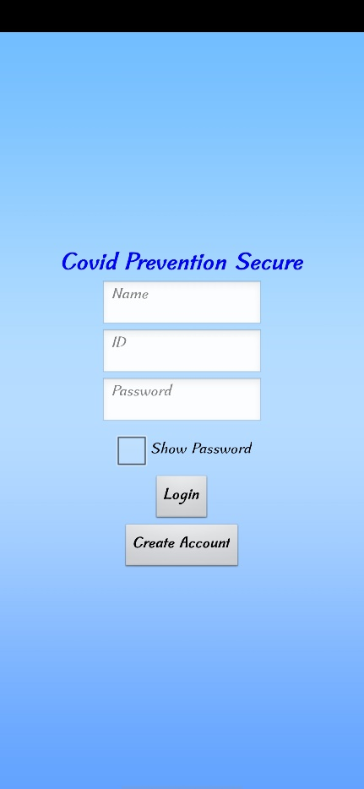
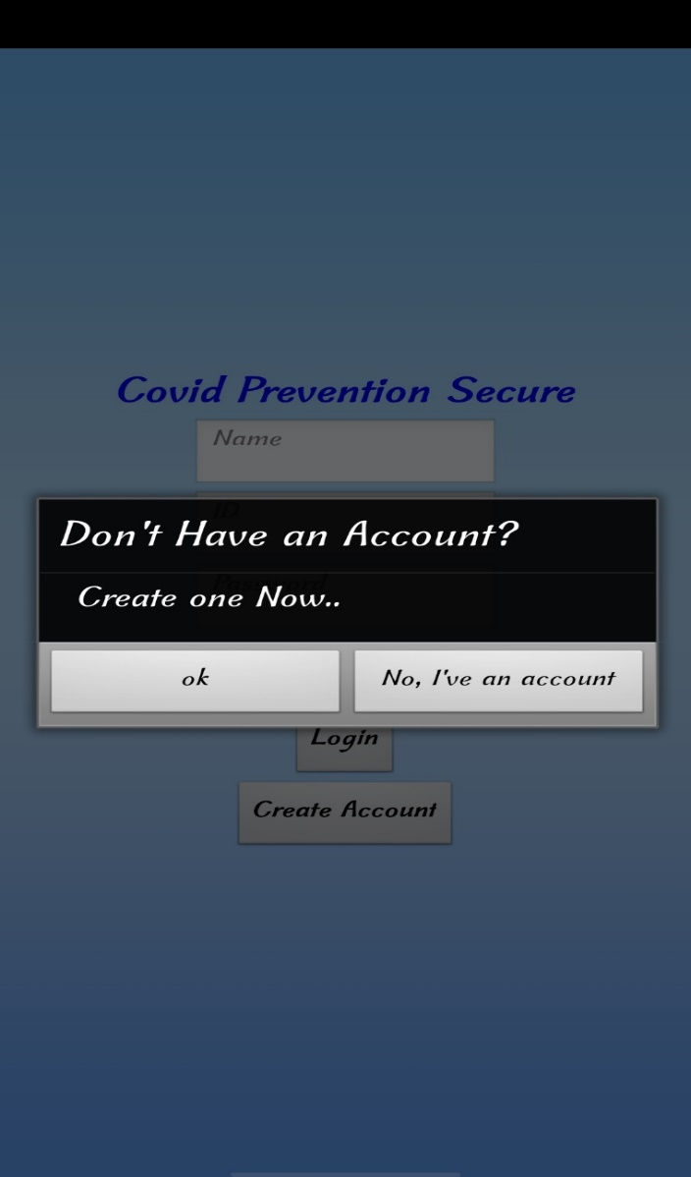
SNAPSHOTS
We’ve to Create an account with Proper Details if we’re using the app for first time

Slide 11
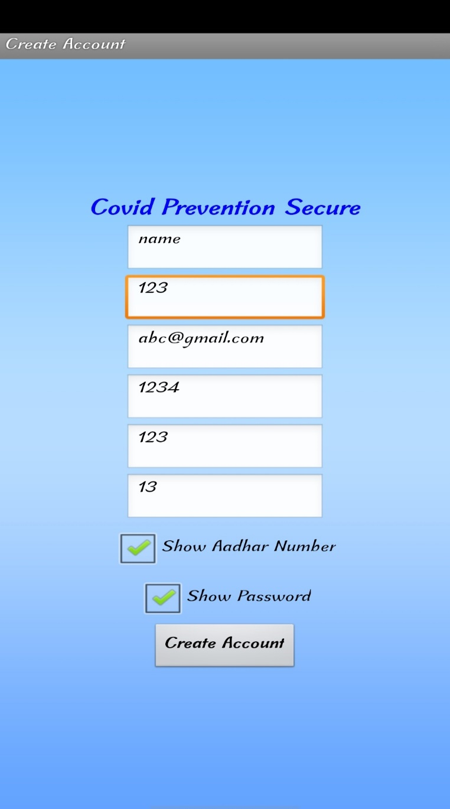
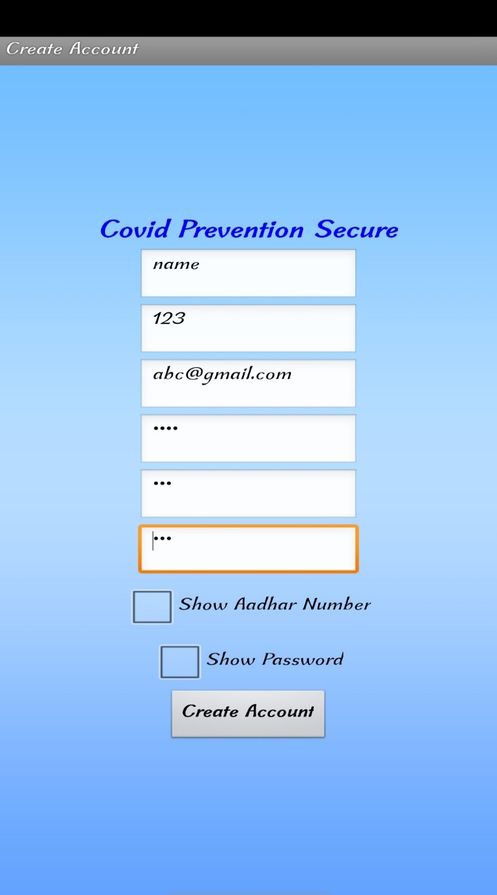
We can hide or unhide the confidential sections like password and Aadhar number

Slide 12
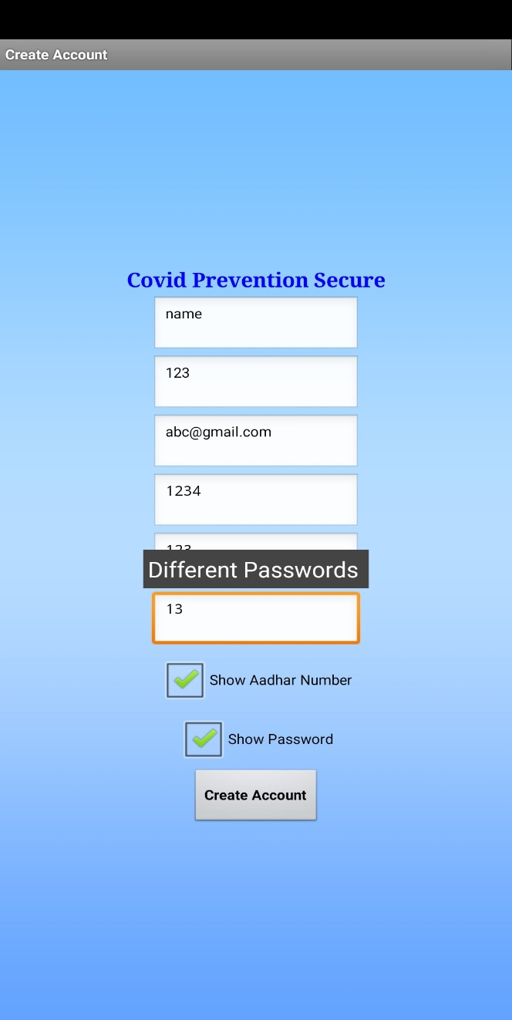
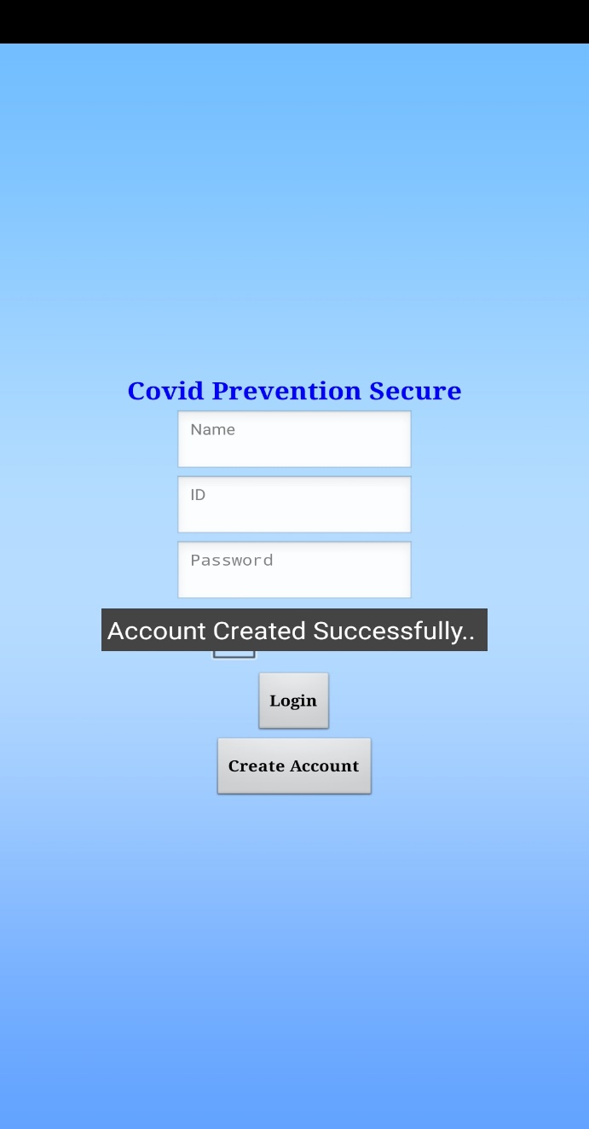
All Fields must be Filled Properly according to their criteria

Slide 13
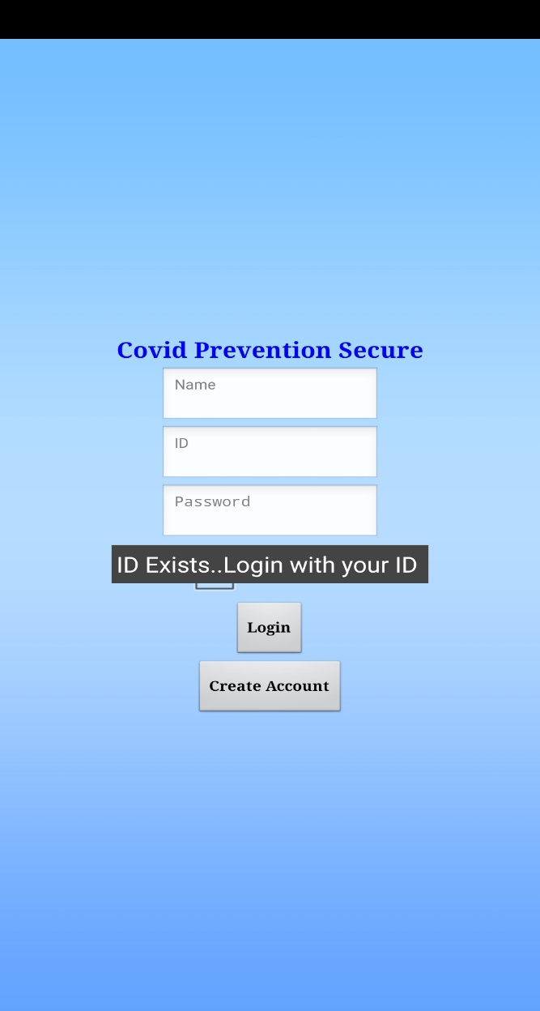
If account already existed then it’ll show a notice that ID Exists

Slide 14
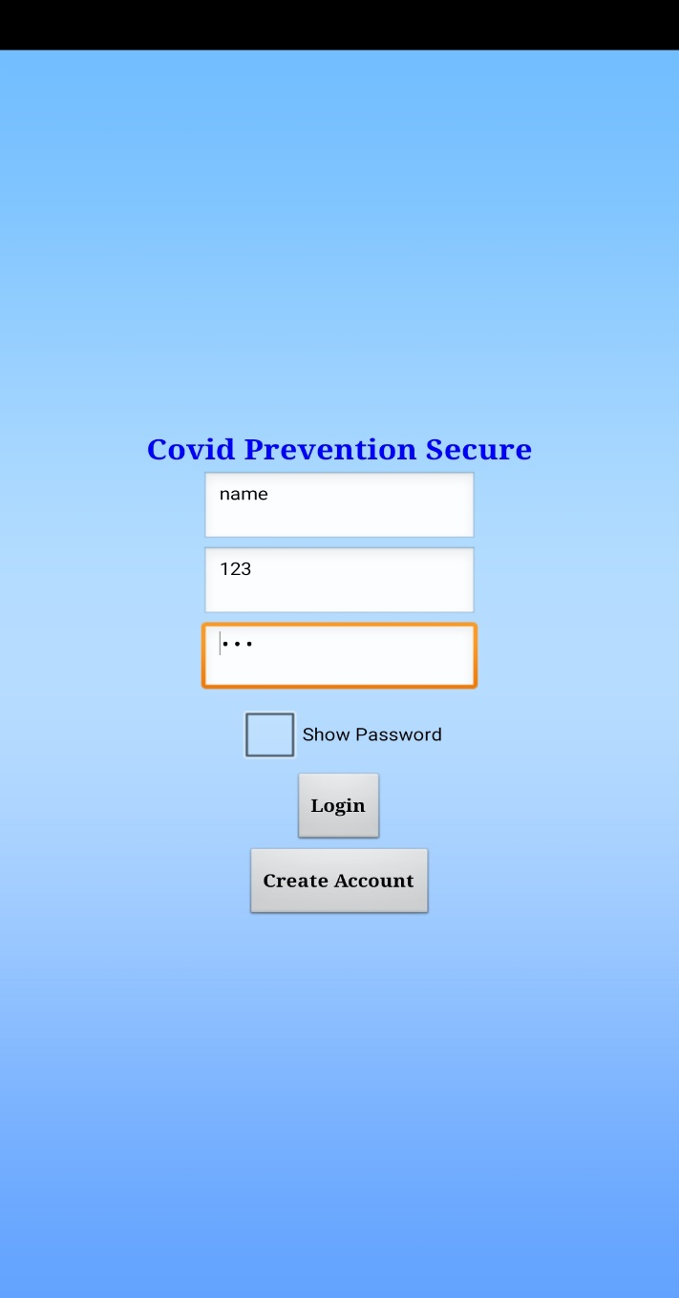
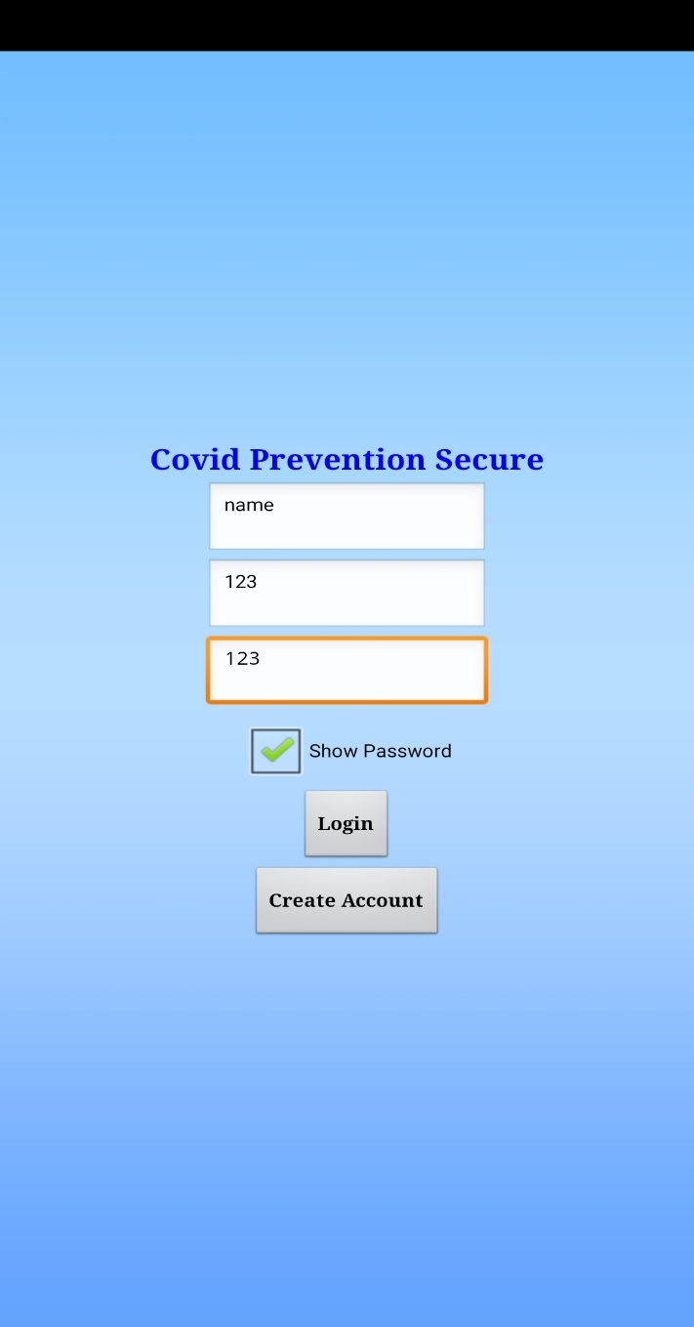
We have to enter Valid Information to login
We can show and hide the password by checking the checkbox

Slide 15
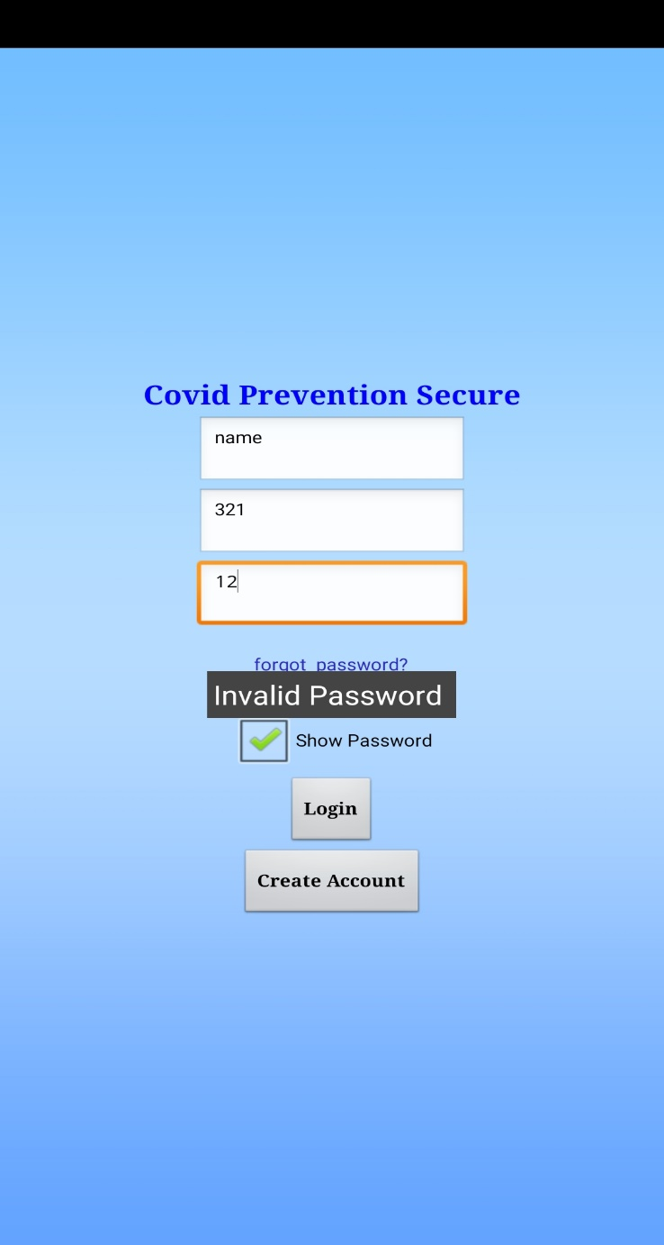
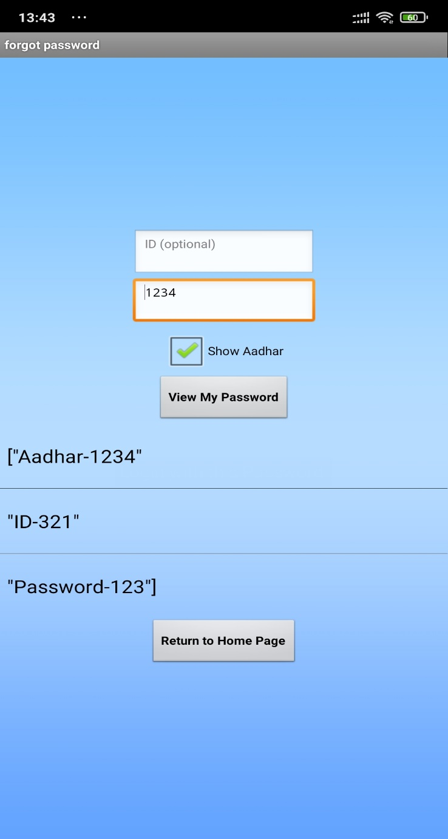
If we forgot the password, the forgot password option will be shown and we can check the password with Aadhar number

Slide 16
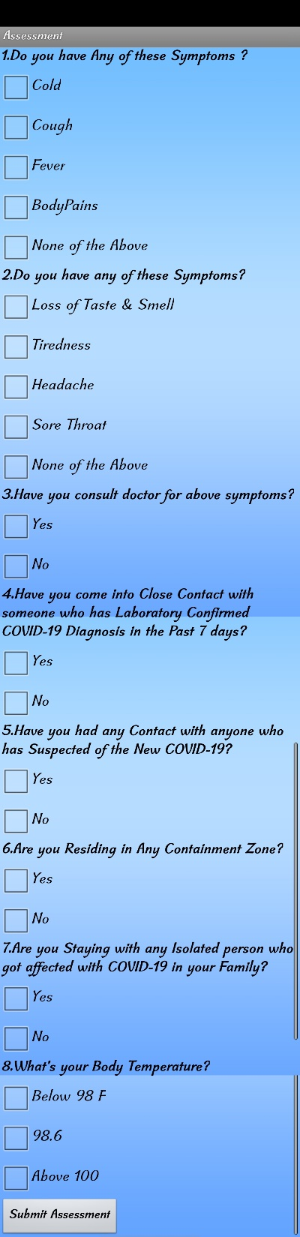
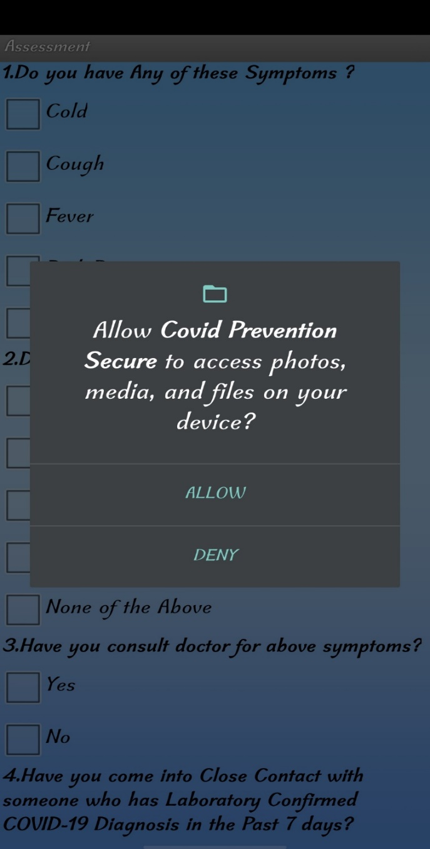
After Login we’ll get Assessment page
Complete the Assesment by checking options
Application needs to store some health data into the device storage

Slide 17
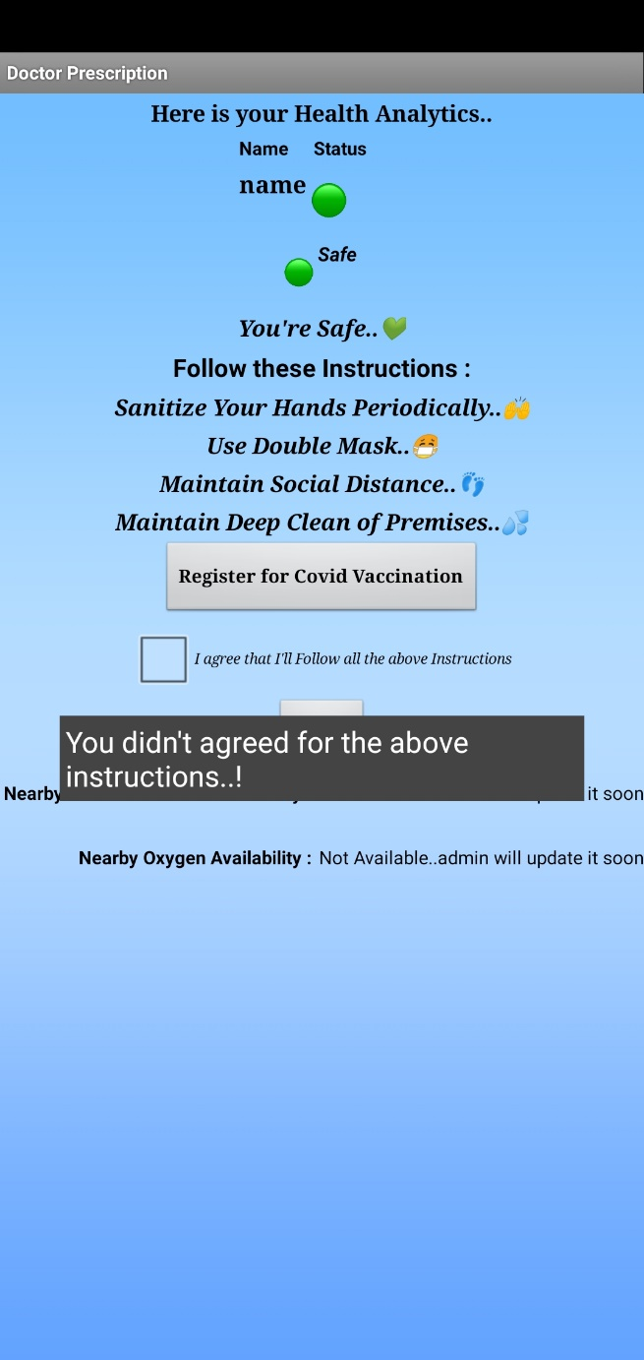
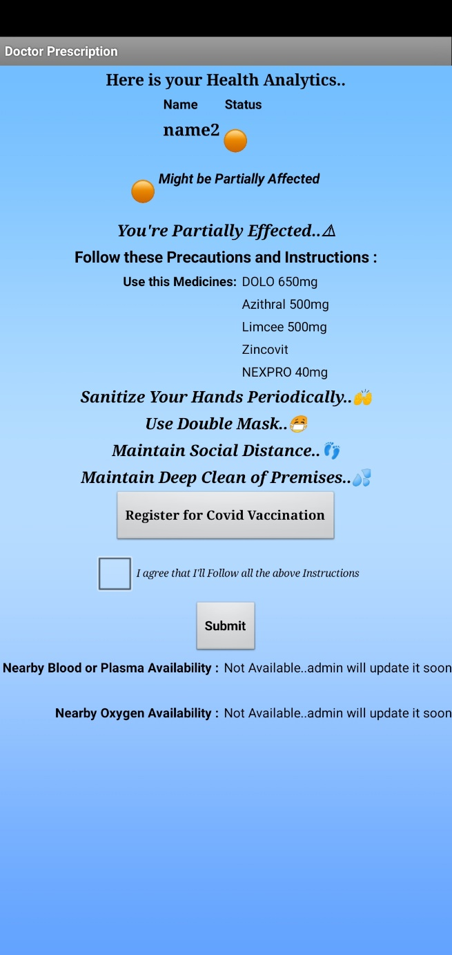
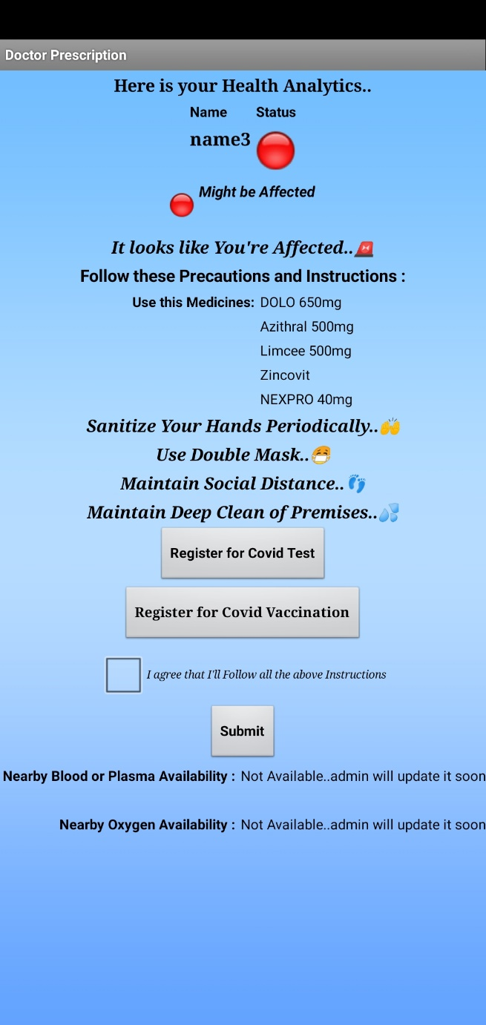
According to Assessment the user will get a color as -
We have to check the box that we’ve to agree the instructions & precautions
Red – Might be Affected
Orange – Might be Partially Effected
Green - Safe

Slide 18

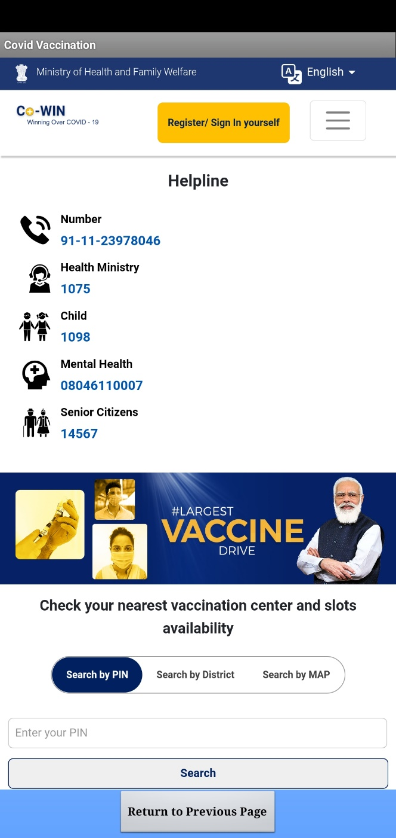
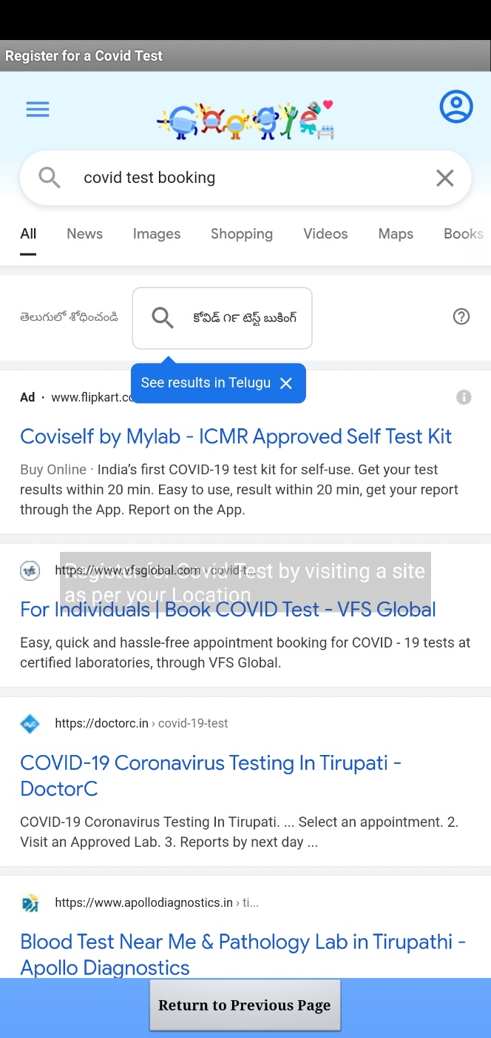
We can book a Covid Test and Covid Vaccination by clicking on the buttons

Slide 19
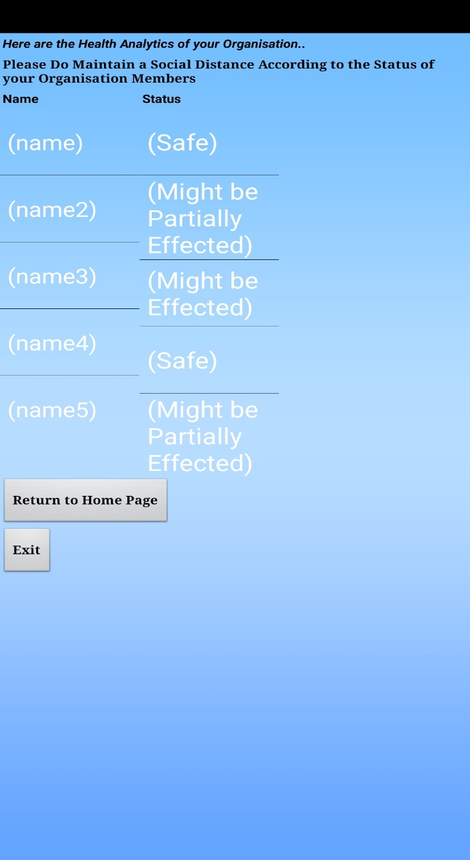
After Submitting the User Health Result, the user can see other’s health result to maintain social distancing

Slide 20
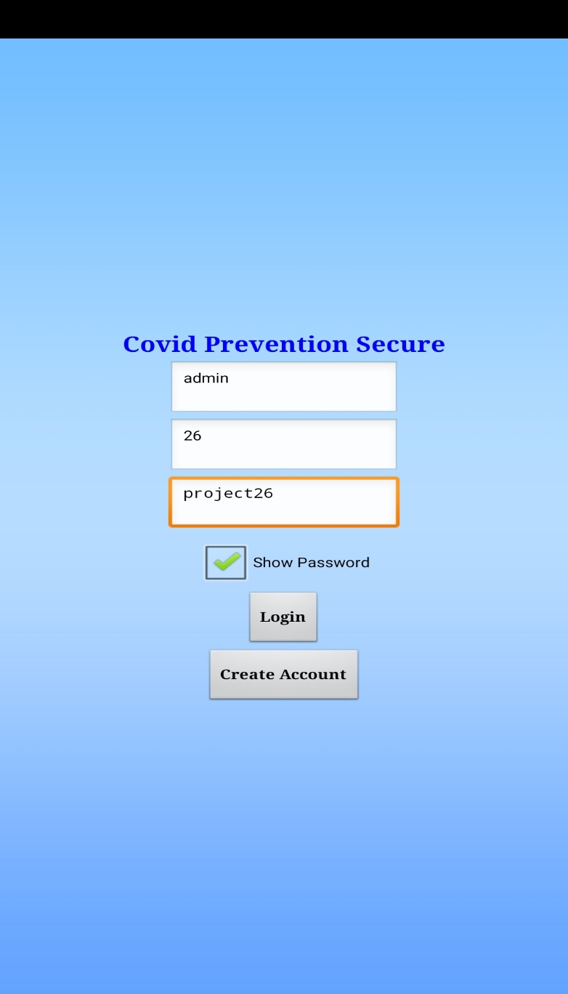
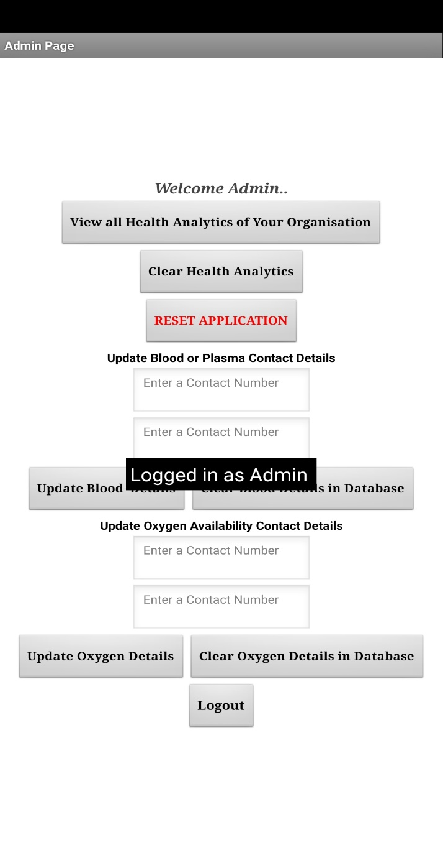
With a default details the admin can login and can make updations in the application

Slide 21
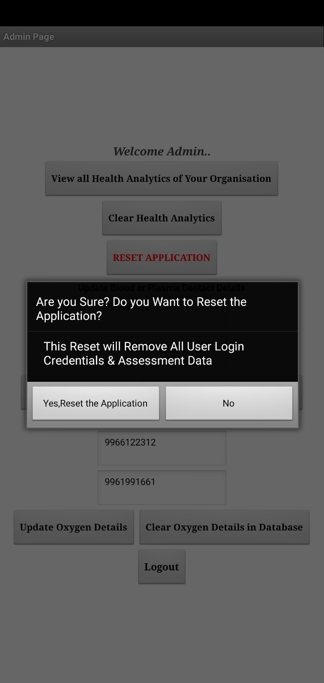
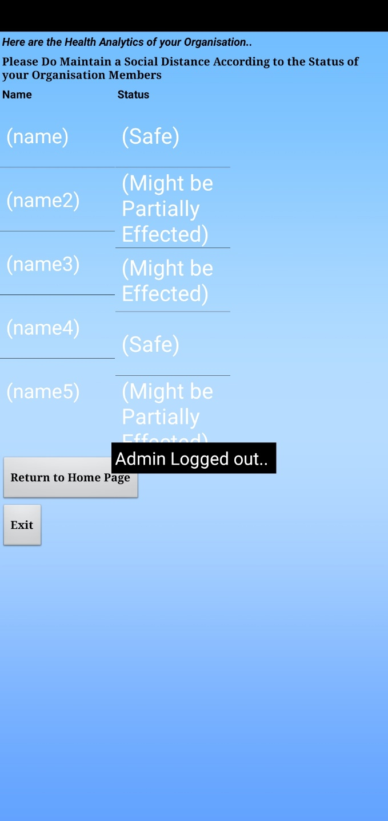
The Admin can Reset the Application and can view the Health Analytics of their Organisation

Slide 22
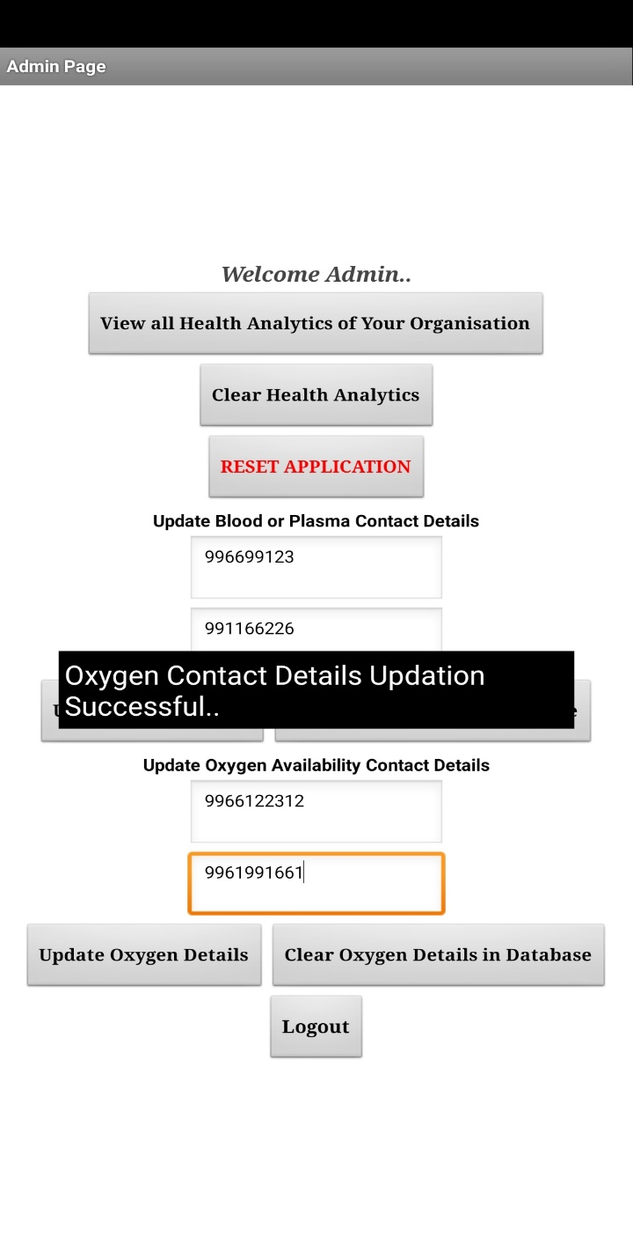
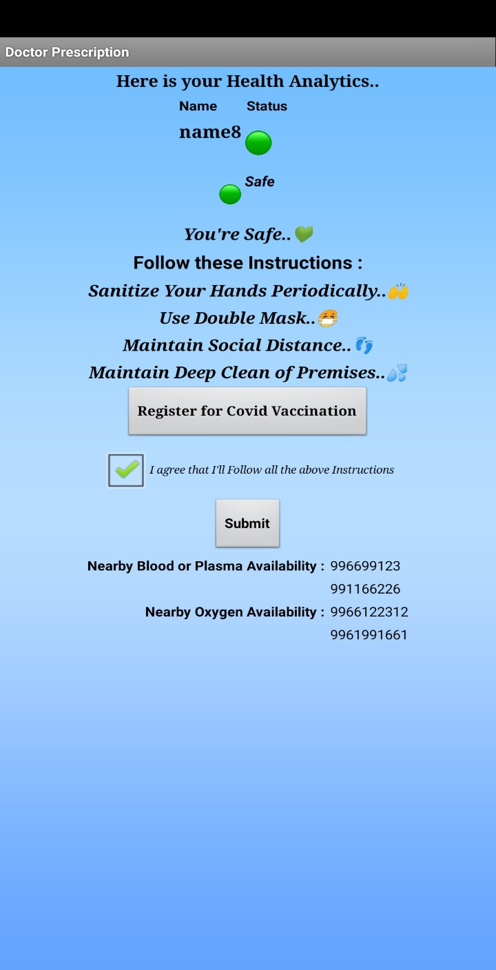
Admin can update the Blood or Plasma and Oxygen contact details in app

Slide 23
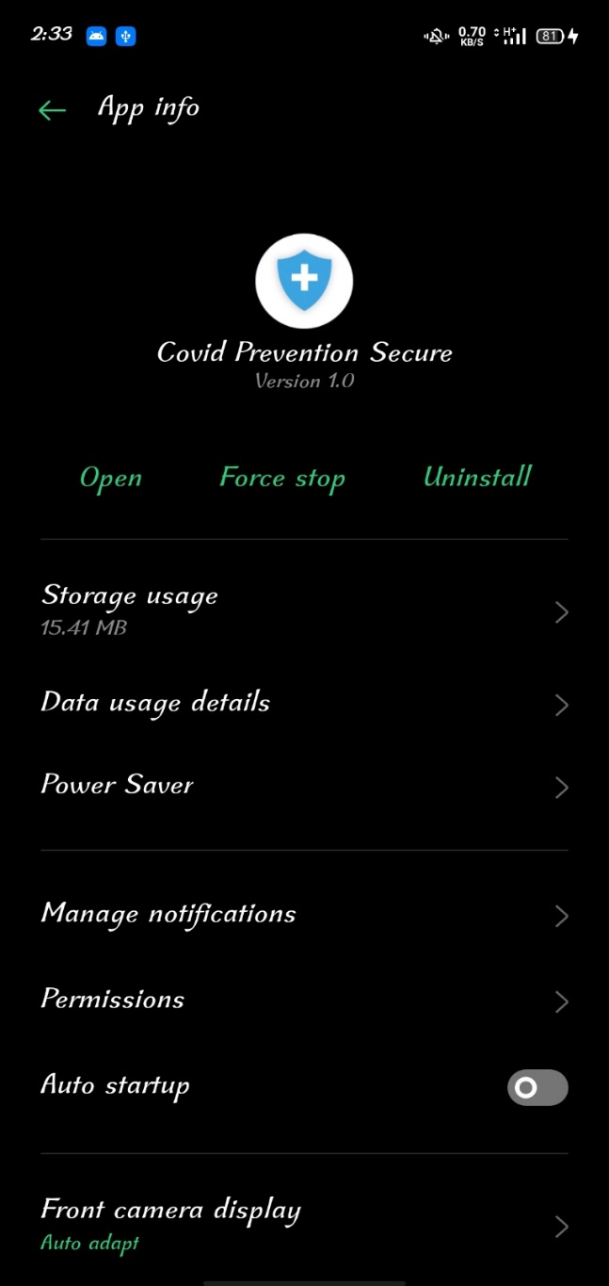
Here’s the Application info..

Slide 24
CONCLUSION
By this Project, we can Prevent the Covid-19 virus Spreading by Maintaining social Distance according to their health status.

Slide 25
FUTURE SCOPE
On Upcoming Future Updates we’ll implement this application to use it for everyone through internet and maintain everyone in social distancing by using Bluetooth sensor technology.
And also we’ll implement that admin can save and print everyone’s assessment result data and their health status in an excel sheet or PDF format.

Slide 26
REFERENCES
https://en.wikipedia.org/wiki/COVID-19
https://www.cdc.gov/coronavirus/2019- ncov/symptoms-testing/coronavirus-self-checker.html
https://www.cowin.gov.in/home
https://www.vfsglobal.com/en/individuals/covid-test.html

Slide 27


Slide 28


